Slide 1
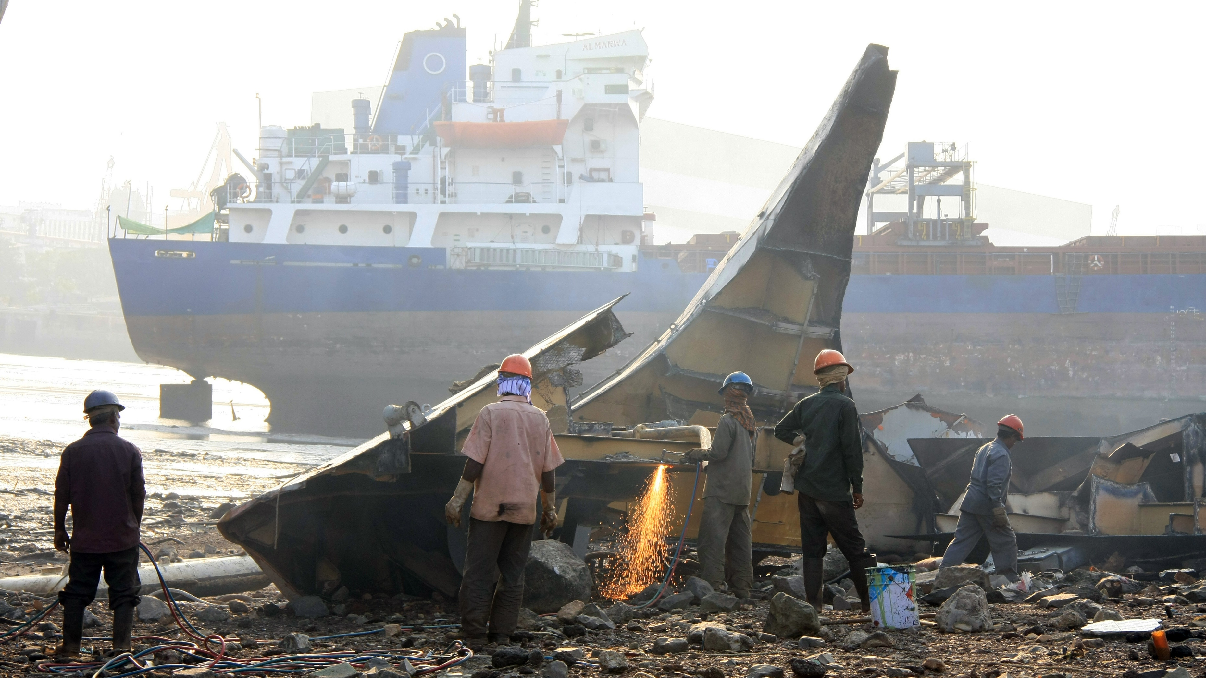

Toolbox due diligence
Dr. Boris Verbrugge (HIVA-KU Leuven)

Slide 2
Sustainability due diligence
Some clarifications

Slide 3
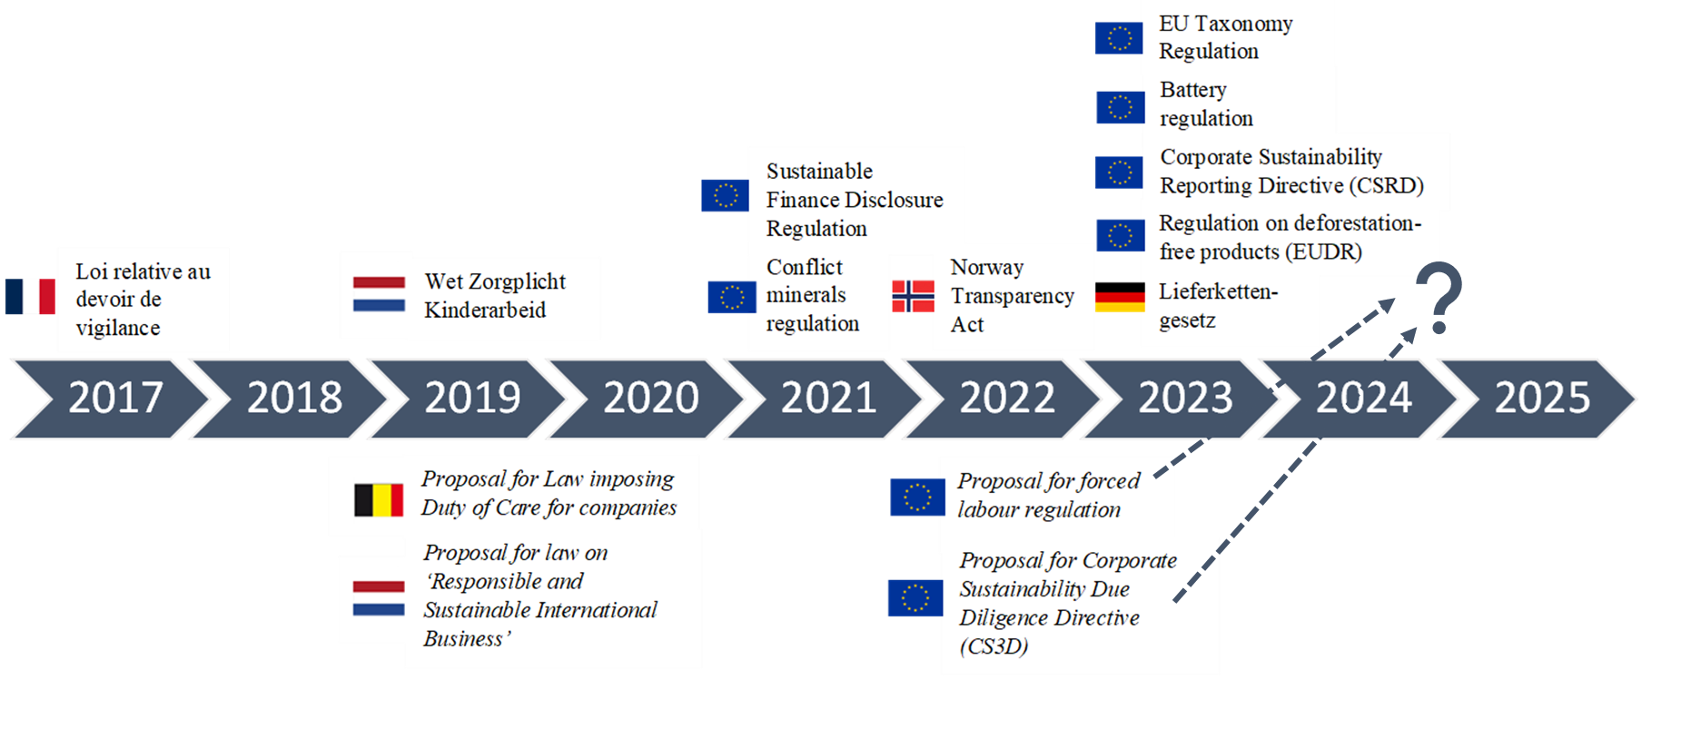

(1) It’s not simply about the Corporate Sustainability Due Diligence Directive (CS3D)
Boris Verbrugge (HIVA-KU Leuven, 2023)

Slide 4
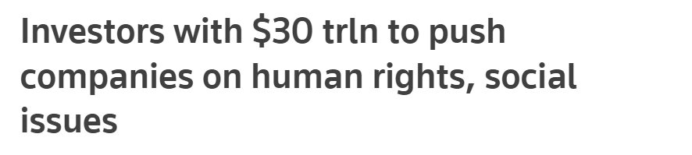
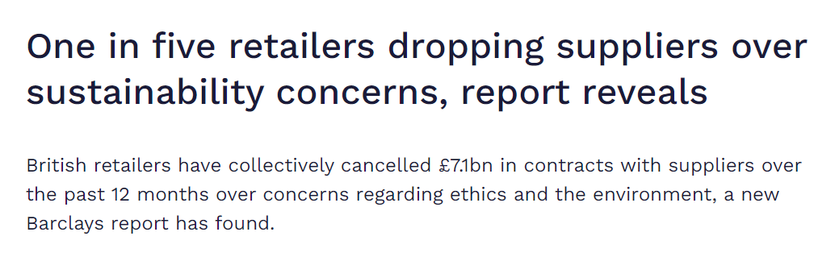

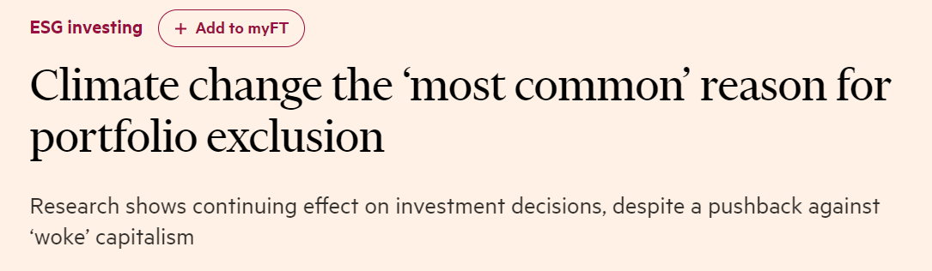
(2) It’s not simply about legal requirements

Slide 5

Misunderstanding (3): It’s not simply about large companies

Slide 6
Due diligence toolbox

Slide 7
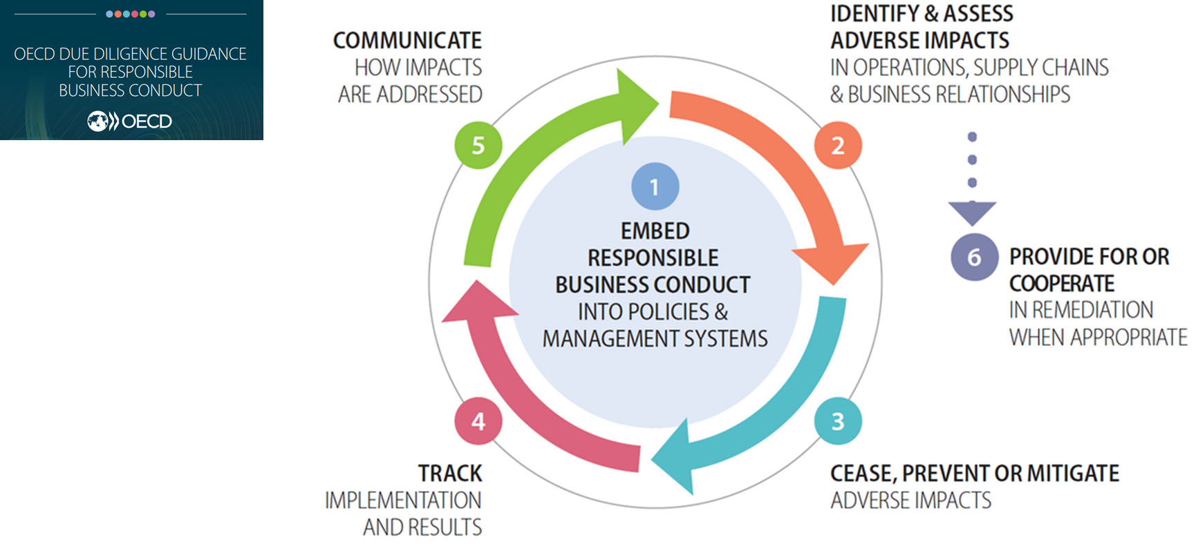
Baseline: lack of (hands-on) due diligence guidance for SMEs

Slide 8
Challenge: develop due diligence guidance for SMEs that is:
Accessible to small companies
Aligned with changing legal- and commercial expectations
Recognizable by including real-life examples

Slide 9
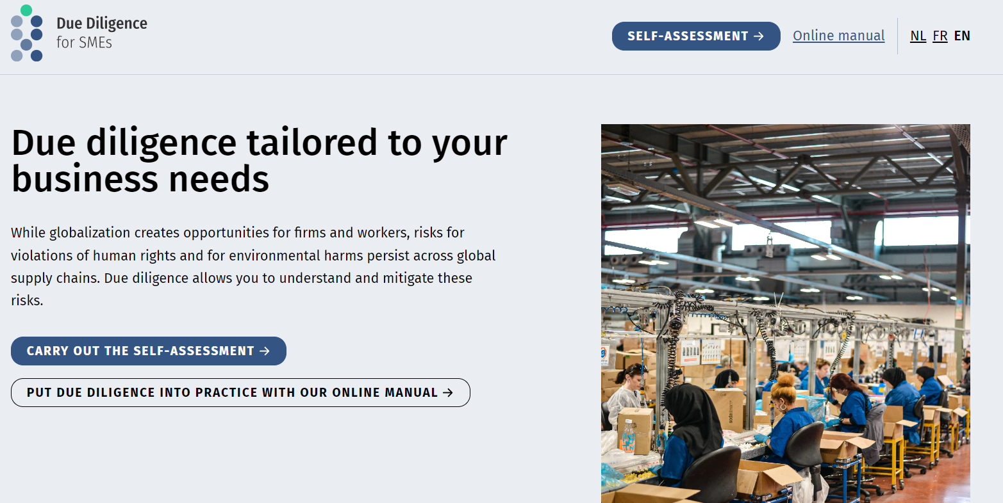

Response: Due diligence toolbox for SMEs
Notes:
Often perceived as highly complex, insufficiently attuned to needs of companies (and particularly SMEs)

Slide 10

Part 1: self-assessment
Notes:
To what extent do you already have experience, expertise, policies or processes to engage with risks

Slide 11
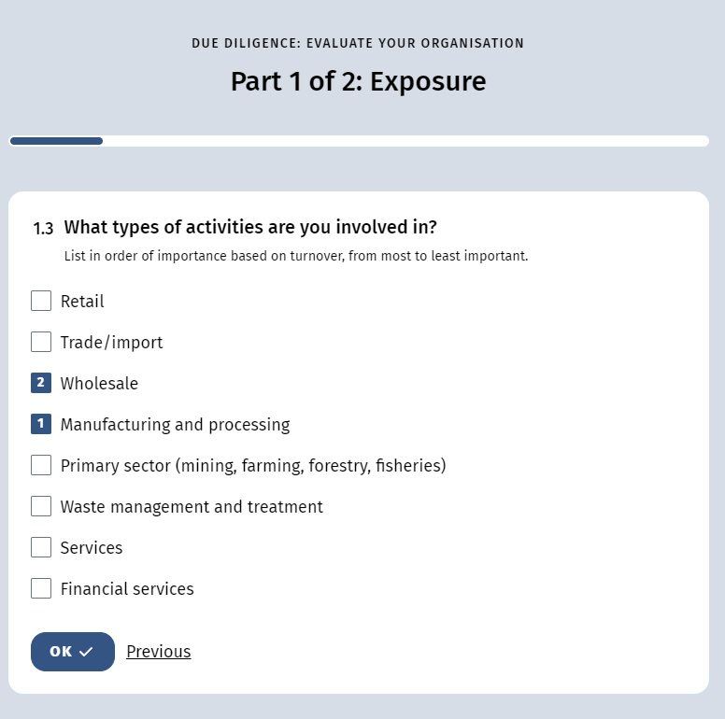
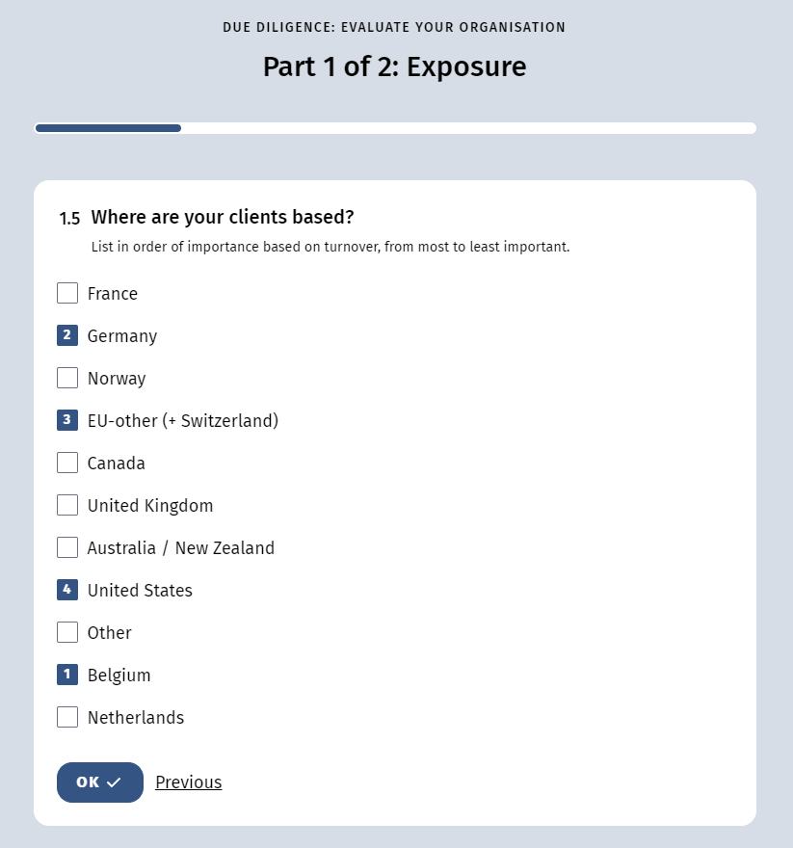

Slide 12
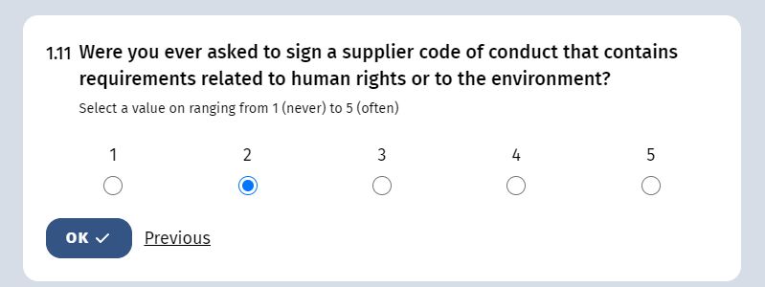
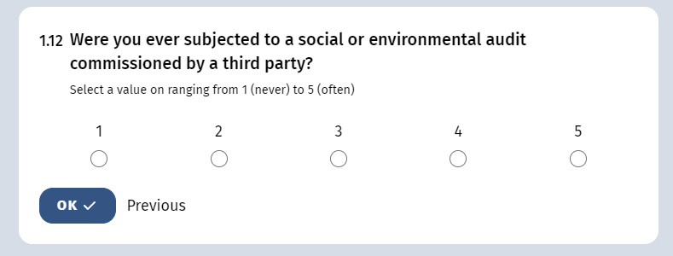
Notes:
Series of straightforward multiple choice questions → first series is aimed at assessing a company’s exposure to due diligence requirements: legislator, market, financial sector, …
=/= exposure to risks to risks (impossible to put into self-assessment), but rather your exposure to expectations and demands to carry out due diligence. Legislator, market, financial sector, …

Slide 13
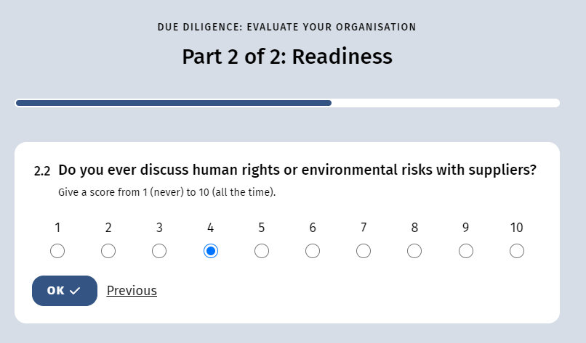
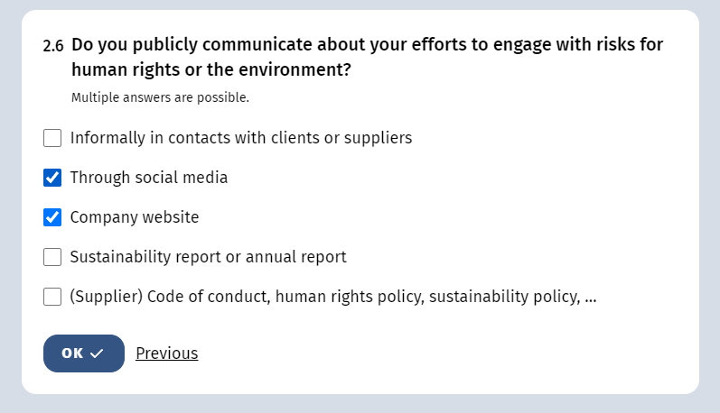

Slide 14
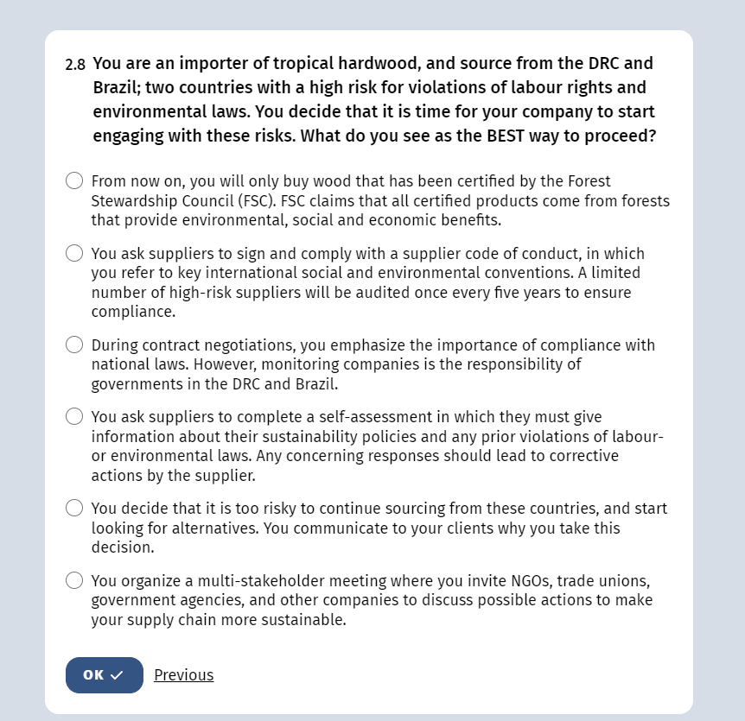

Slide 15
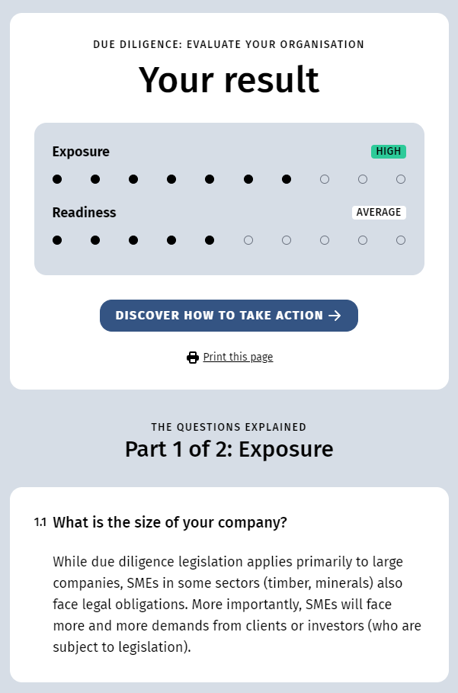
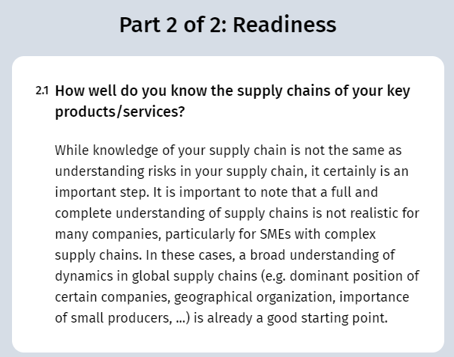

Slide 16
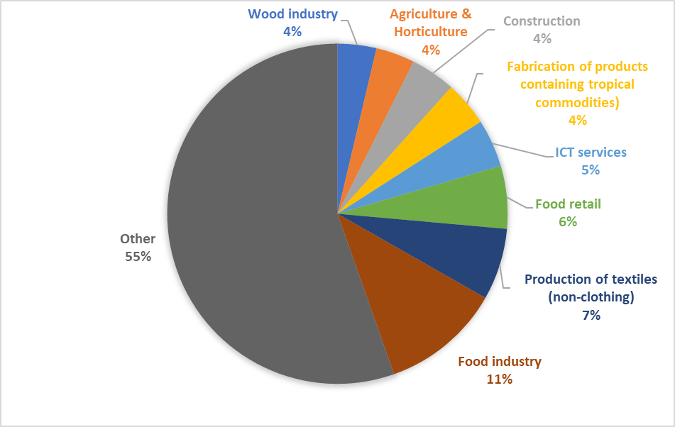
11 months, 384 unique records

Slide 17
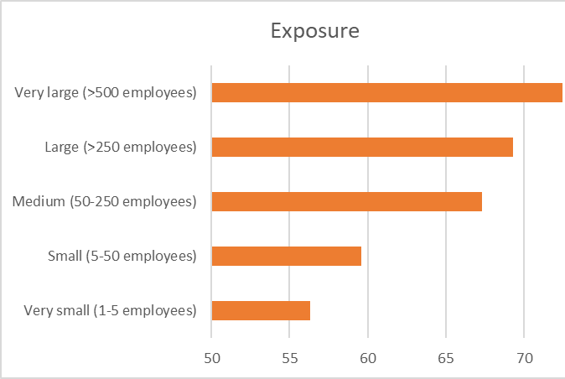
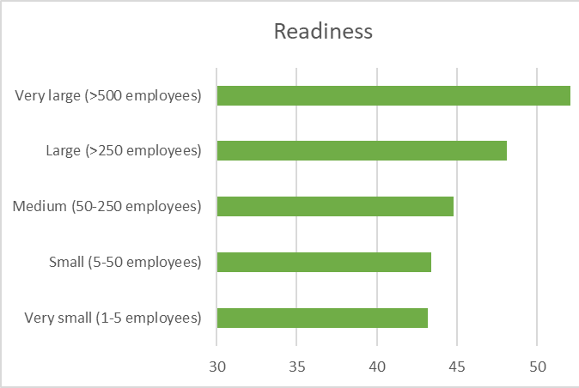


Company size
Average score exposure = 65,3/100
Average score readiness = 47/100

Slide 18
Sectors most exposed to due diligence requirements
 | Sector | Exposure | Readiness
1 | Production of products containing tropical commodities (soy, cocoa, palm oil, coffee, nuts, tropical fruits) | 81 | 50
2 | Production of pharmaceuticals | 80 | 36
3 | Extraction of minerals and fossil fuels | 76 | 45
4 | Wood and wood products (retail) | 76 | 55
5 | Forestry | 76 | 43
6 | Production of clothes and leather products | 73 | 48
7 | Logistical services | 73 | 55
8 | Production of textiles (other) | 73 | 45
9 | Textiles: retail, wholesale, distribution | 73 | 50
10 | Agriculture & horticulture | 72 | 44

Slide 19
Sectors best prepared for due diligence requirements
 | Sector | Readiness
1 | Logistical services | 55
2 | Wood and wood products (retail) | 55
3 | Production of paper products | 53
4 | Energy | 51
5 | Textiles: retail, wholesale, distribution | 50
6 | Production of products containing tropical commodities (soy, cocoa, palm oil, coffee, nuts, tropical fruits) | 50
7 | Retail: food and drinks | 48
8 | Production of electronics and ICT | 48
9 | Production of clothes and leather products | 48
10 | ICT services | 48
11 | Food industry | 48
12 | Retail: paper & paper products | 48

Slide 20
Sectors least prepared for due diligence requirements
 | Sector | Readiness
1 | Fisheries | 33
2 | Production of pharmaceuticals | 36
3 | Financial sector | 38
4 | Construction | 39
5 | Retail: Electronics and ICT | 39
6 | Wood industry | 40
7 | Chemical industry | 42
8 | Wholesale (other) | 42
9 | Production of articles containing wood or cork (including furniture) | 42
10 | Forestry | 43

Slide 21

Part 2: online manual

Slide 22
Risk identification
Risk mitigation
Policy integration

Slide 23
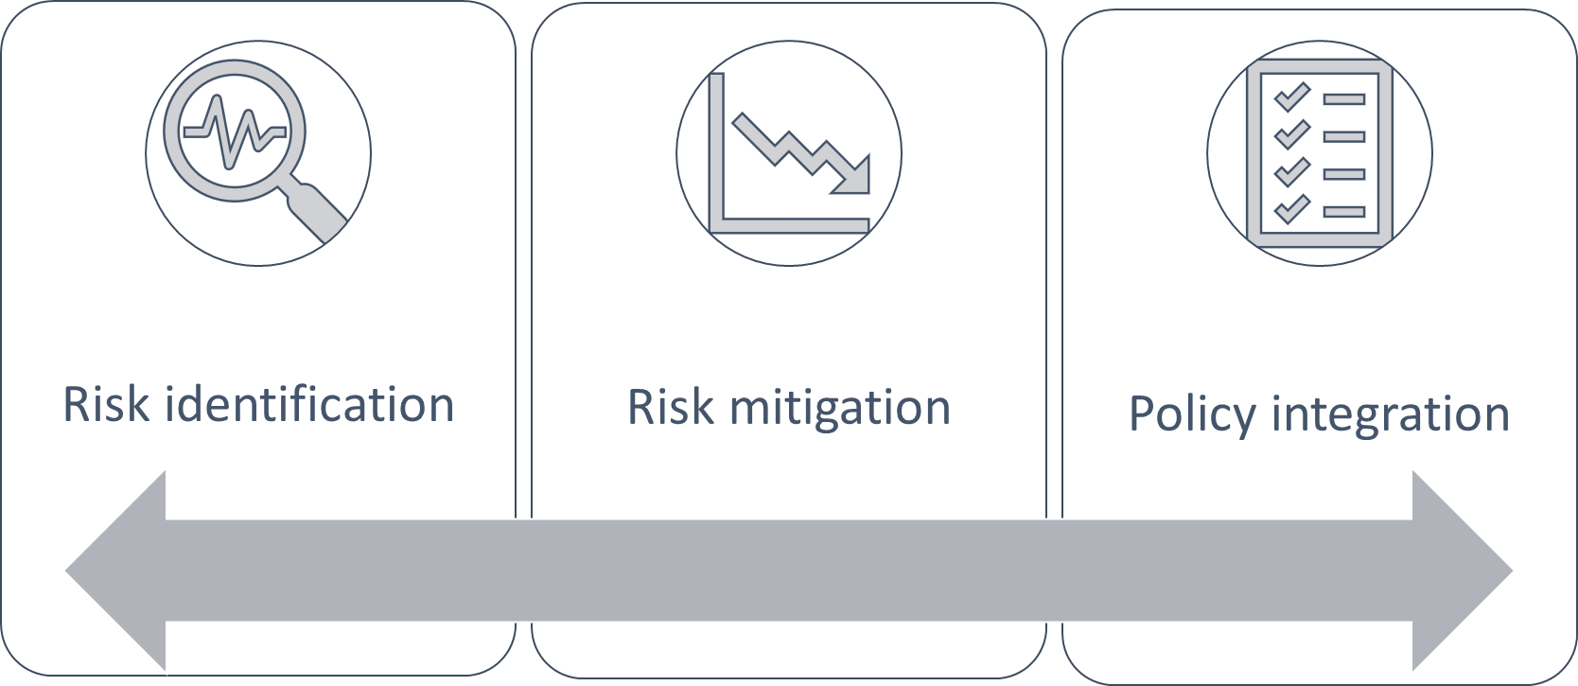
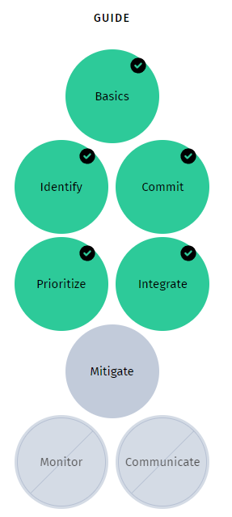

Slide 24
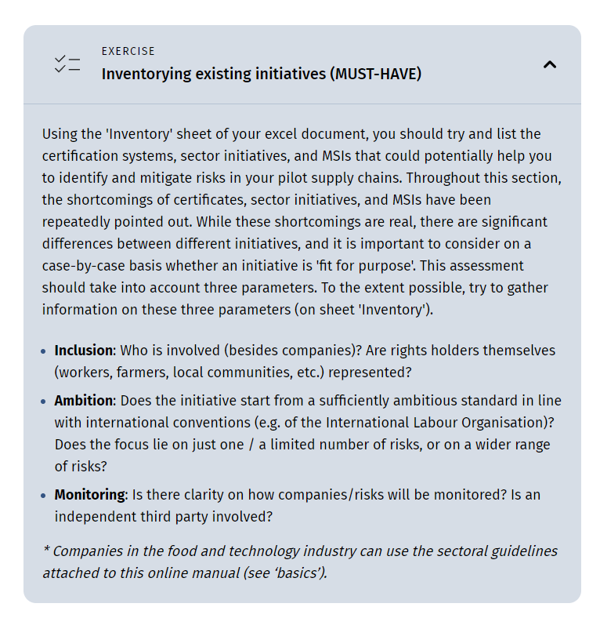
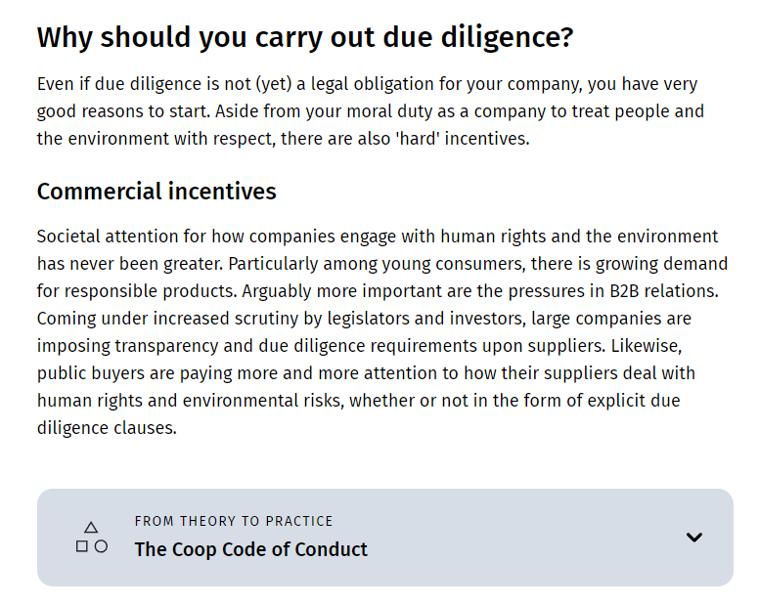

Notes:
Throughout, we have really sought to limit the amount of tekst, sticking with the essence and integrating practical examples and exercises in drop-down menus

Slide 25
Notes:
A overview of existing tools, sources, guidelines, templates, etc.

Slide 26
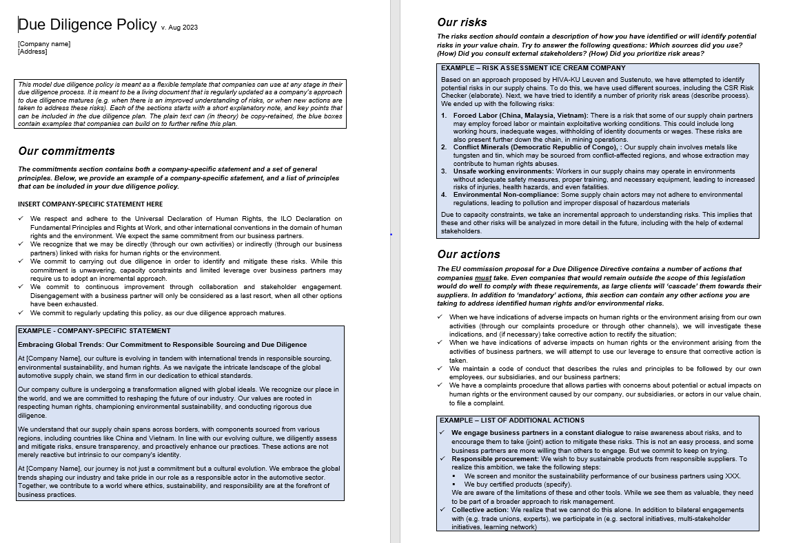

Slide 27
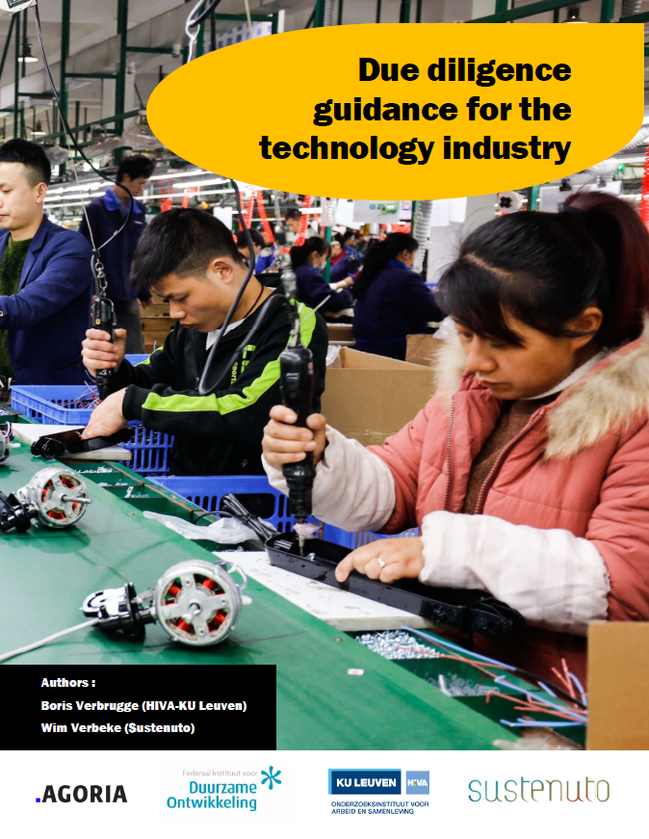
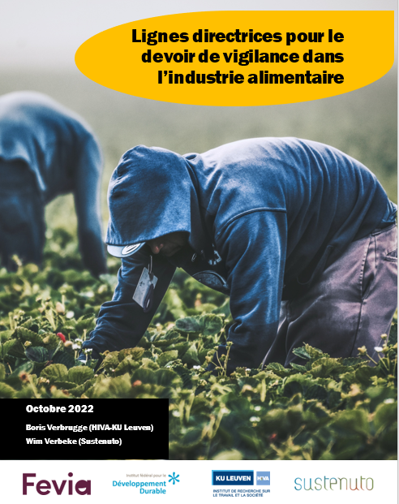

Slide 28
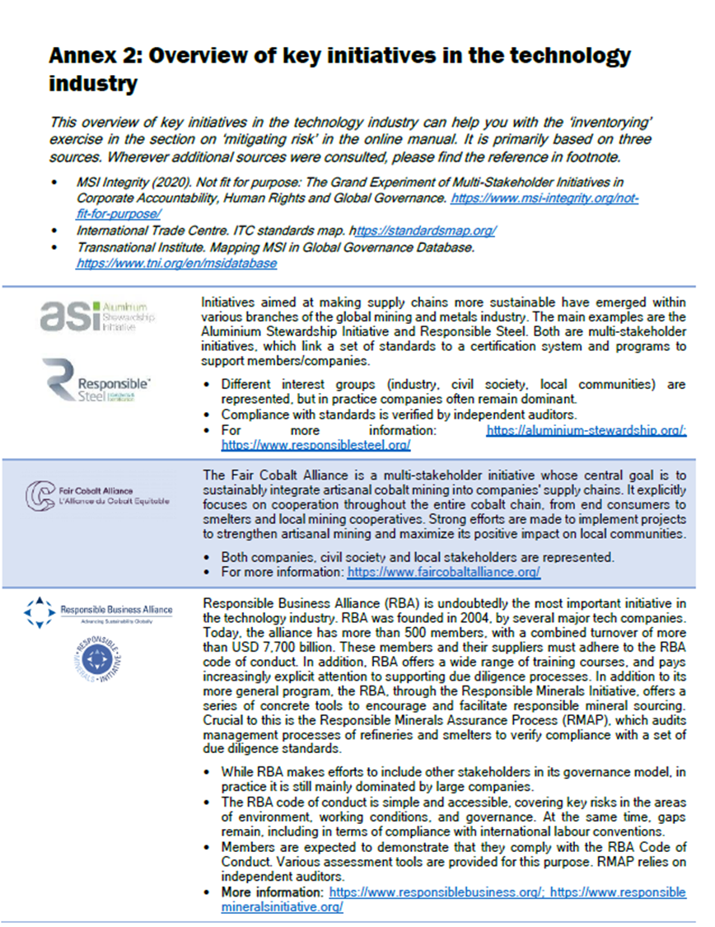
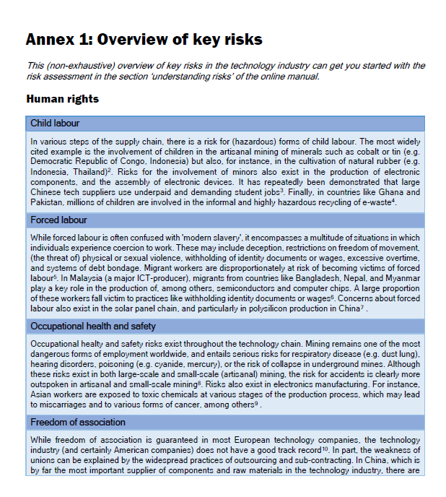

Slide 29
www.duediligencetoolbox.be boris.verbrugge@kuleuven.be

